Slide 1
Waiving Target Animal Batch Safety Testing for vaccines
Ken NODA, DVM PhD
National Veterinary Assay Laboratory,
Ministry of Agriculture, Forestry and Fisheries, Tokyo, Japan
Presented at VICH Training session in ASEAN, April, 2017

Slide 2
Disclaimer
These slides have been provided for training purposes only. The presenter has made every attempt to ensure that they are consistent with relevant VICH guideline(s).
As always, the original Guideline(s) should be used as the primary source of information for working with regulators.

Slide 3
VICH 3Rs Statement
At its 19th meeting in 2007 in USA, the SC reiterated its ambition to minimise animal testing
Support for the 3Rs principle
  replacement, refinement and reduction
[Statement of Principle for VICH - Alternatives to Animal Testing (VICH/07/038-Final; 18/09/2007)]

Slide 4
What is batch safety test (BST) ?
Tests in target and/or laboratory animals
  For Final product of broad group of vaccines
Considered as general safety tests
  Vaccines may change its safety/toxicity batch to batch
  Need assurance that a batch will be safe
BST should uncover;
  Abnormal local or systemic reactions (EU)
  Unfavorable reactions (US)
  Abnormal changes (Japan)
Notes:
Most batch safety tests in laboratory and/or target animals on final product can be considered as general safety tests. They apply to a broad group of vaccines and should provide some assurance that the product will be safe in the target species, i.e. it should reveal “abnormal local or systemic reactions” (European Pharmacopoeia) or “unfavorable reactions attributable to the biological product ...” (Title 9. United States Code of Federal Regulations) or “no abnormal changes” (Minimum Requirements for Veterinary Biological Products under the Pharmaceutical Affairs Law in Japan).

Slide 5
Are BSTs for vaccines necessary?
Decreased concern on adverse reactions of vaccines
Due to the Improvements in
-Quality of raw materials
-Culture / Purification method
-Assay method
-Seed lot system / GMP standard
-Safety testing under GLP standard

Slide 6
What is TABST GL?
Formal name:
  Harmonisation of criteria to waive target animal batch safety testing for inactivated vaccines for veterinary use
Very exceptional in whole VICH GLs
  Usual GLs are test requirement for registration
  TABST GL is applied to vaccine already registered in the past
It shows how to discontinue TABST
  An administrative guidance
  The SC accepted this exception for the 3Rs principle

Slide 7
Development of BST GLs: History
2008 | EU proposed harmonization of BST SC concluded to adopt a step-wise approach 1 : TABST for inactivated vaccines (GL50) 2 : TABST for live vaccines (GL55) 3 : Laboratory Animal BST for all vaccines
2009 -12 | BQM EWG–TABST subgroup elaborated draft GL50
2012 | SC approval draft GL50 / Public consultation
2013 | Final GL50 published, giving 1 year for implementation.
2014 | VICH GL50 implemented
2015 | The subgroup elaborated draft GL55
2016 | SC approval draft GL55 / Public consultation
2017 | Final GL55 published soon

Slide 8
Categorization of BST Waiver GLs:
Animal Species | Inactivated Vaccine | Live Vaccine
Target Animals | GL50 | GL55
Laboratory Animals | On going

Slide 9
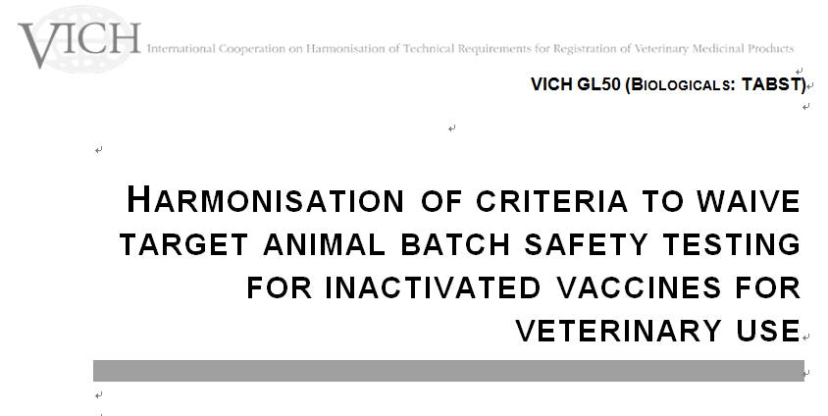

Slide 10
VICH-GL50
2. GUIDELINE
2.1. Scope
    This guideline is limited to the criteria on data requirements for waiving target animal batch safety tests (TABST) of inactivated veterinary vaccines.
2.2. Regional Requirements
  2.2.1. General batch safety testing
    Current procedure for TABST in VICH region.
  2.2.2. Other relevant requirements
    Good Manufacturing Practice (GMP)
    Seed lot system
    Pharmacovigilance

Slide 11
VICH-GL50
2.3. Data requirements for waiving of target animal batch safety tests
  2.3.1. Introduction
  The TABST may be waived by the regulatory authority when;
  a sufficient number of consecutive production batches have been produced and
  comply with the tests (on specification), thus
  demonstrate consistency of the manufacturing process.

Slide 12
VICH-GL50
2.3.1.1. The characteristics of the product and its manufacture
The manufacturer should demonstrate that the product is manufactured following the quality principles (e.g. seed lot system and GMP)
When other batch tests in target animals (e.g. potency tests) are conducted during the manufacturing process, it is recommended to gain additional safety data of the vaccine.

Slide 13
VICH-GL50
2.3.1.2. Information available on the current batch safety test
  The manufacturer should submit batch protocol data for a sufficient number of consecutive batches (Usually 10 batches)
  to demonstrate that safe and consistent production has been established.
    The conduct of the TABST shall be in accordance with the regional requirements.
    Variety of local and systemic reactions should be examined,
    Summary and discussion should be provided.

Slide 14
VICH-GL50
2.3.1.3. Pharmacovigilance data
A pharmacovigilance system (in accordance with the VICH Guidelines) is in place during the consecutive batches were on the market.
The Data to demonstrating the consistent safe performance of the vaccine in the field should be provided.

Slide 15
VICH-GL50
2.3.2. Procedure for waiving the target animal batch safety test
  A report should provide an overall assessment of the consistency of the product’s safety and
  would include;
    the number of batches manufactured,
    the number of years the product has been on the market,
    the number of doses sold,
    the frequency and seriousness of any adverse reactions,
    investigations into the causes of these adverse reactions.

Slide 16
How is GL50 implemented in Japan ?
GL50 has been implemented in Japan from Feb. 2014.
1. Applicable vaccine
The vaccine which is fulfilled all of following requirements.
(1) Inactivated vaccine for veterinary use.
(2) More than the last 10 batches were passed the TABST.
(3) Seed lot system-based product.
(4) Product which is not within the re-examination period
(6 years after the approval).

Slide 17
How is GL50 implemented in Japan ?
2. Application Documents
(1) Application for waiver of TABST
(2) Accompanying materials:
  A. Manufacturing records (last 10 batches)
  B. Batch release test data (last 10 batches)
  C. Information on a defect batch (if any)
  D. Revision history of the dossier
  E. Rational explanation for waiving TABST (on A to D above)
  F. Overall safety assessment including Pharmacovigilance data

